Slide 1
Government Polytechinc,Yavatmal Android Application For Potholes Detection System Course- Capstone Project Execution & Report Writing
Submitted by: Guided By:
Ayush Chiddarwar (1970) Prof. G.K. Yadav
Pranjal Sharma (1854)
Diksha Mohod (1839)
Prajwal Chaudhari (1965)
Manthan Watile (1969)

Slide 2
Contents
Introduction
Resource and technology applied
Working of Project
Graphical Representation of Working
Flowchart and Diagram
Outputs and some images of project
Advantages and Disadvantages
Application of project
Scope for Future
Importance of Project
Conclusion

Slide 3
Introduction
The pothole on the road causes serious harm to drivers’ safety. Therefore, drivers’ safety may be improved with the establishment of real-time pothole detection system for sharing the pothole information. This study proposes a pothole detection method based on the mobile sensing and shares the pothole information with road users and government. For this purpose, the mobile device should be equipped with G-sensors and GPS to collect accelerometer data and location information. Our project aims to create an Android Application that automatically records potholes and logs their exact location using Latitude and Longitude, also it records the severity of pothole to estimate the danger. This will hopefully significantly increase the numbers of potholes reported which will help the local authority to maintain the road condition, help them to trace the pothole and repair it. Ultimately creating a safer, enjoyable and smooth road journeys. The data collected by this application can be used for the study and survey purpose, saving lot of resources like time, money, man power etc.

Slide 4
Resource and technology applied
Server side:-
Client side (application):-
XAMPP Server
PHP
JSON
Php MyAdmin
MySQL
HTML
Domain name and Server
space(hosting)
JAVA
JSON
Android Studio
Emulator

Slide 5
Working of Project
Accelerometer detects the change in the acceleration. So, it detects the pothole and send it to the server along with co-ordinates and intensity. This application collects the pothole data, get their exact location through GPS, calculate the intensity and send it to the server. As soon the sensor starts capturing the data it test every value captured to a pre-defined value. If the captured value is larger than the pre-defined value then it is considered as a pothole and will throw a message on the screen as “ Data Uploaded Successfully “ and it will upload data to the server at the same time creating a vibration effect to denote the operation has been done successfully. It provide information to user about the history of potholes in a tabular format, user can locate the exact position of potholes on google maps.

Slide 6

Graphical Representation of Working

Slide 7
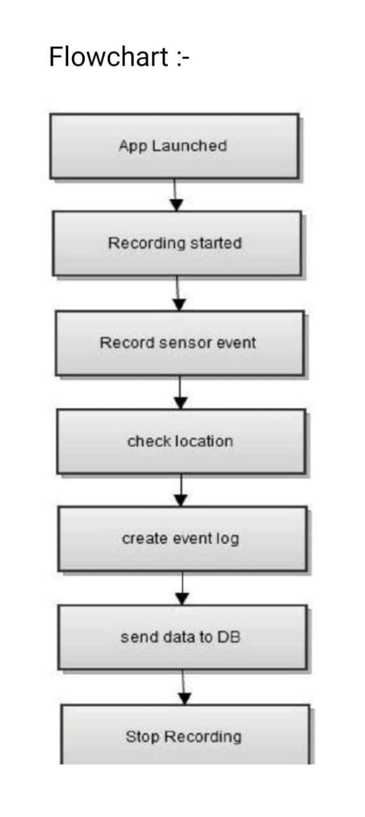
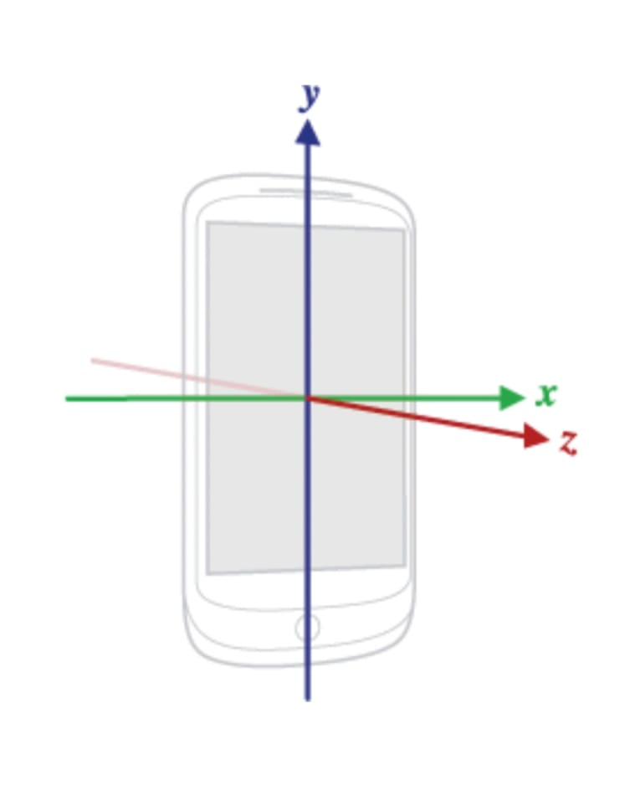
Flowchart and Diagram

Slide 8
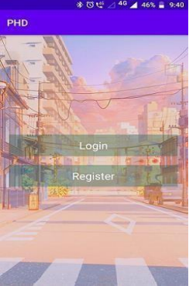
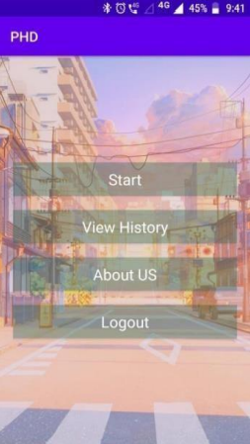
Output and some images of project

Slide 9
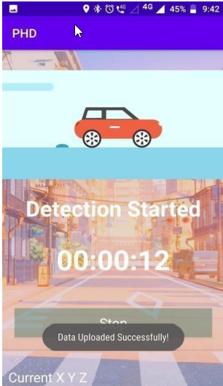
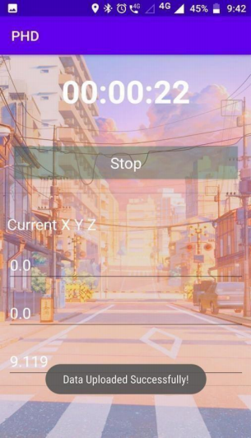
Working of Application

Slide 10
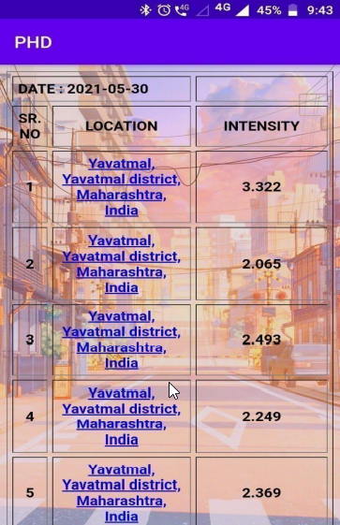
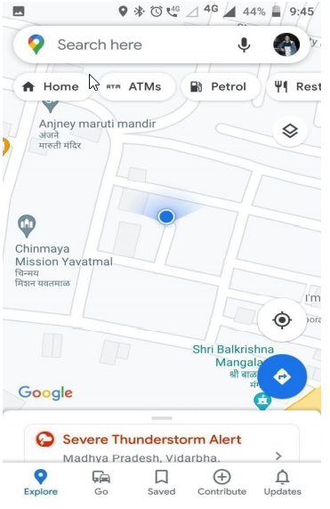
History and Location

Slide 11
Advantages and Disadvantages
Advantage
Disadvantage
Problem of road accidents due to potholes can be tackled.
GPS tracks the location of pothole and sends it to server .
Helps to enhance the road safety and security.
Can be used as a survey tool for measuring road health and quality of work.
Sensors output may vary from device to device.
Good internet connection is required for functioning.
High battery consumption.

Slide 12
Application of Project
- To detect and locate potholes.
- To study the road health/condition in different weathers, regions, and states.
- To take survey of road networks and the no. of potholes.
- To collect the data for cost estimation of road repair and maintenance.
- Data collected by this application is crucial for study purpose and help the government and local authority to use their resources in proper manner and take actions on potholes.
- Data collected by this application can be used by MNC’s and firms for business and marketing purpose.

Slide 13
Scope For Future
This application can be integrated with google maps, so that user can get the information about the road condition, along with the traffic.
Principles used in this application can be applied into the computer of cars and other vehicles, so that there will be no need of smartphones to detect the pothole.
This application can be developed further to detect the unevenness, gravel road conditions and speed bumps.
This application can be optimized to reduce the battery consumption.
Currently this application works on Android Operating System but it can be developed for other Operating System users like IOS and Windows.
Also, Gyroscope can be taken into consideration to sense the deviation in the road surface to calculate other factors.
This application can be modified to work without internet connection or in poor connectivity areas. This can be achieved by using array or stack to store data temporarily on the user device.

Slide 14
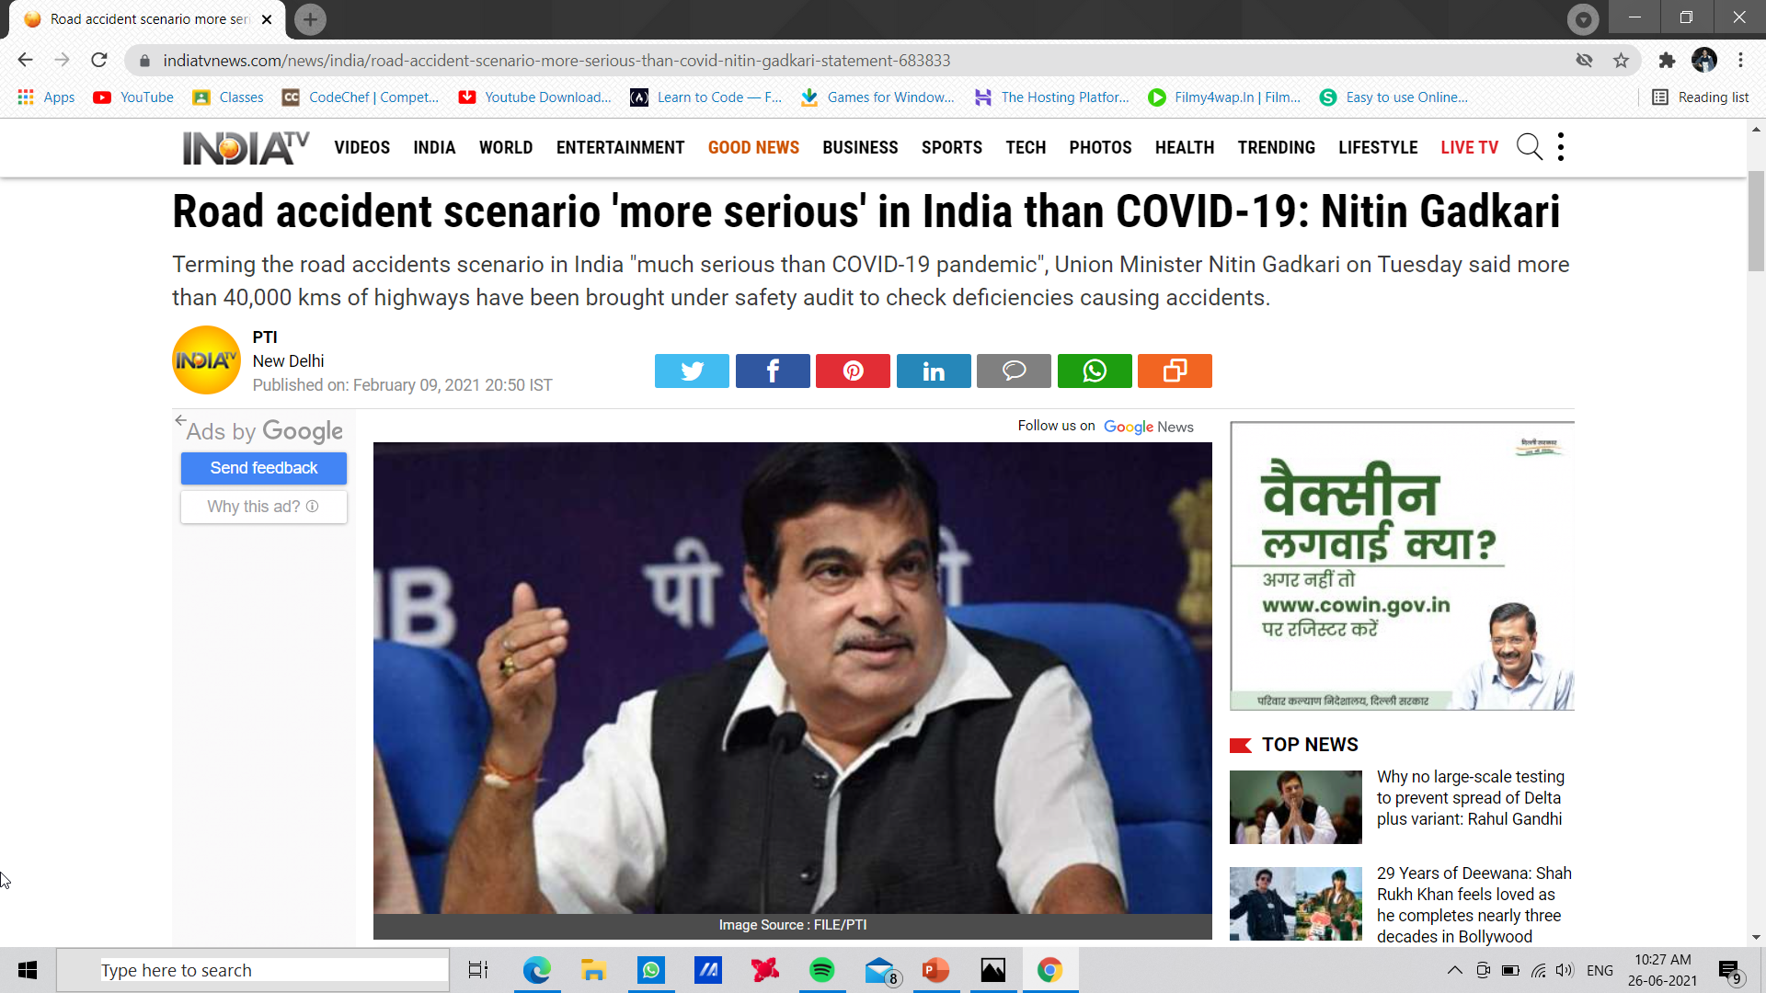
Importance of this Project

Slide 15
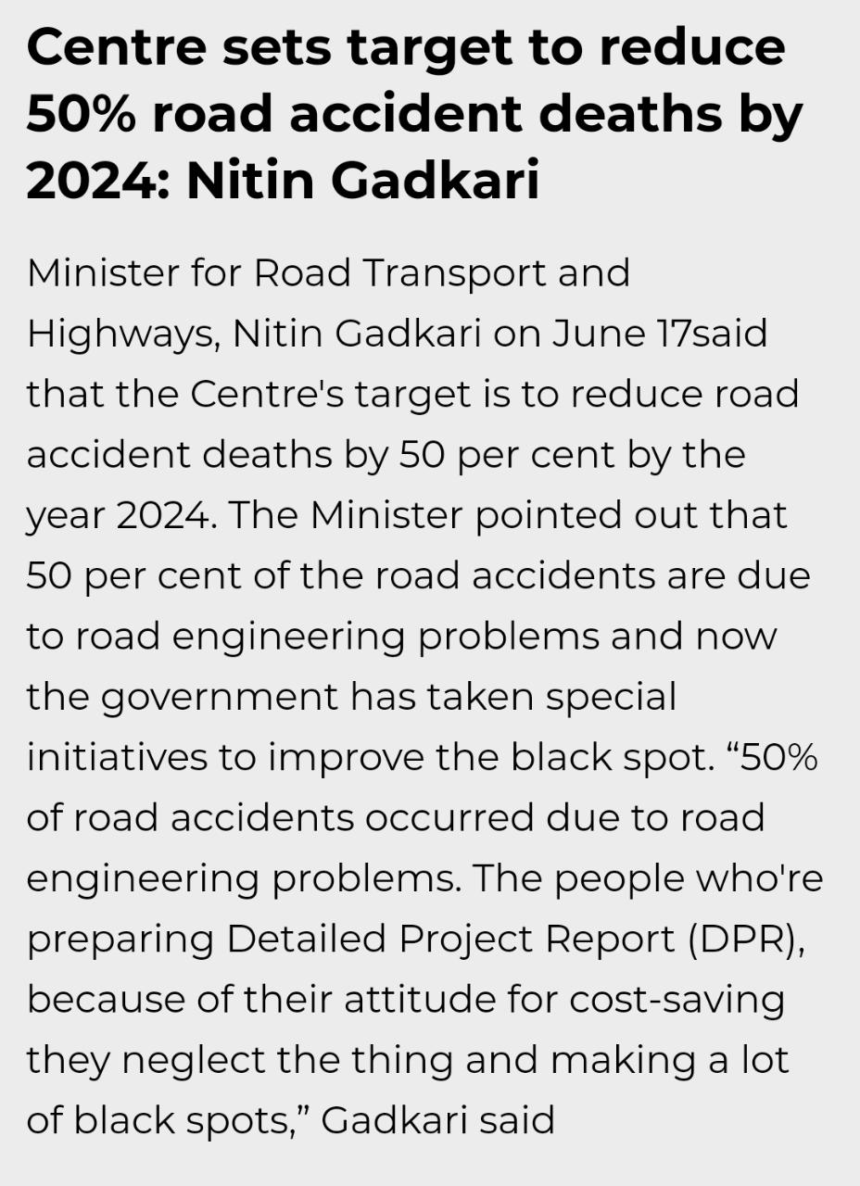

Slide 16
Conclusion
So far “Pothole Detection” works well and it achieve all the characteristic of an good application. It is easy to use it has simple and minimalistic GUI and decent performance.
It successfully stores data into database and provides all the necessary services to user.
A problem which can be seen in this application is that it’s battery consumption is high as it uses GPS, accelerometer and vibration motor.

Slide 17
Thank You...

